Slide 1
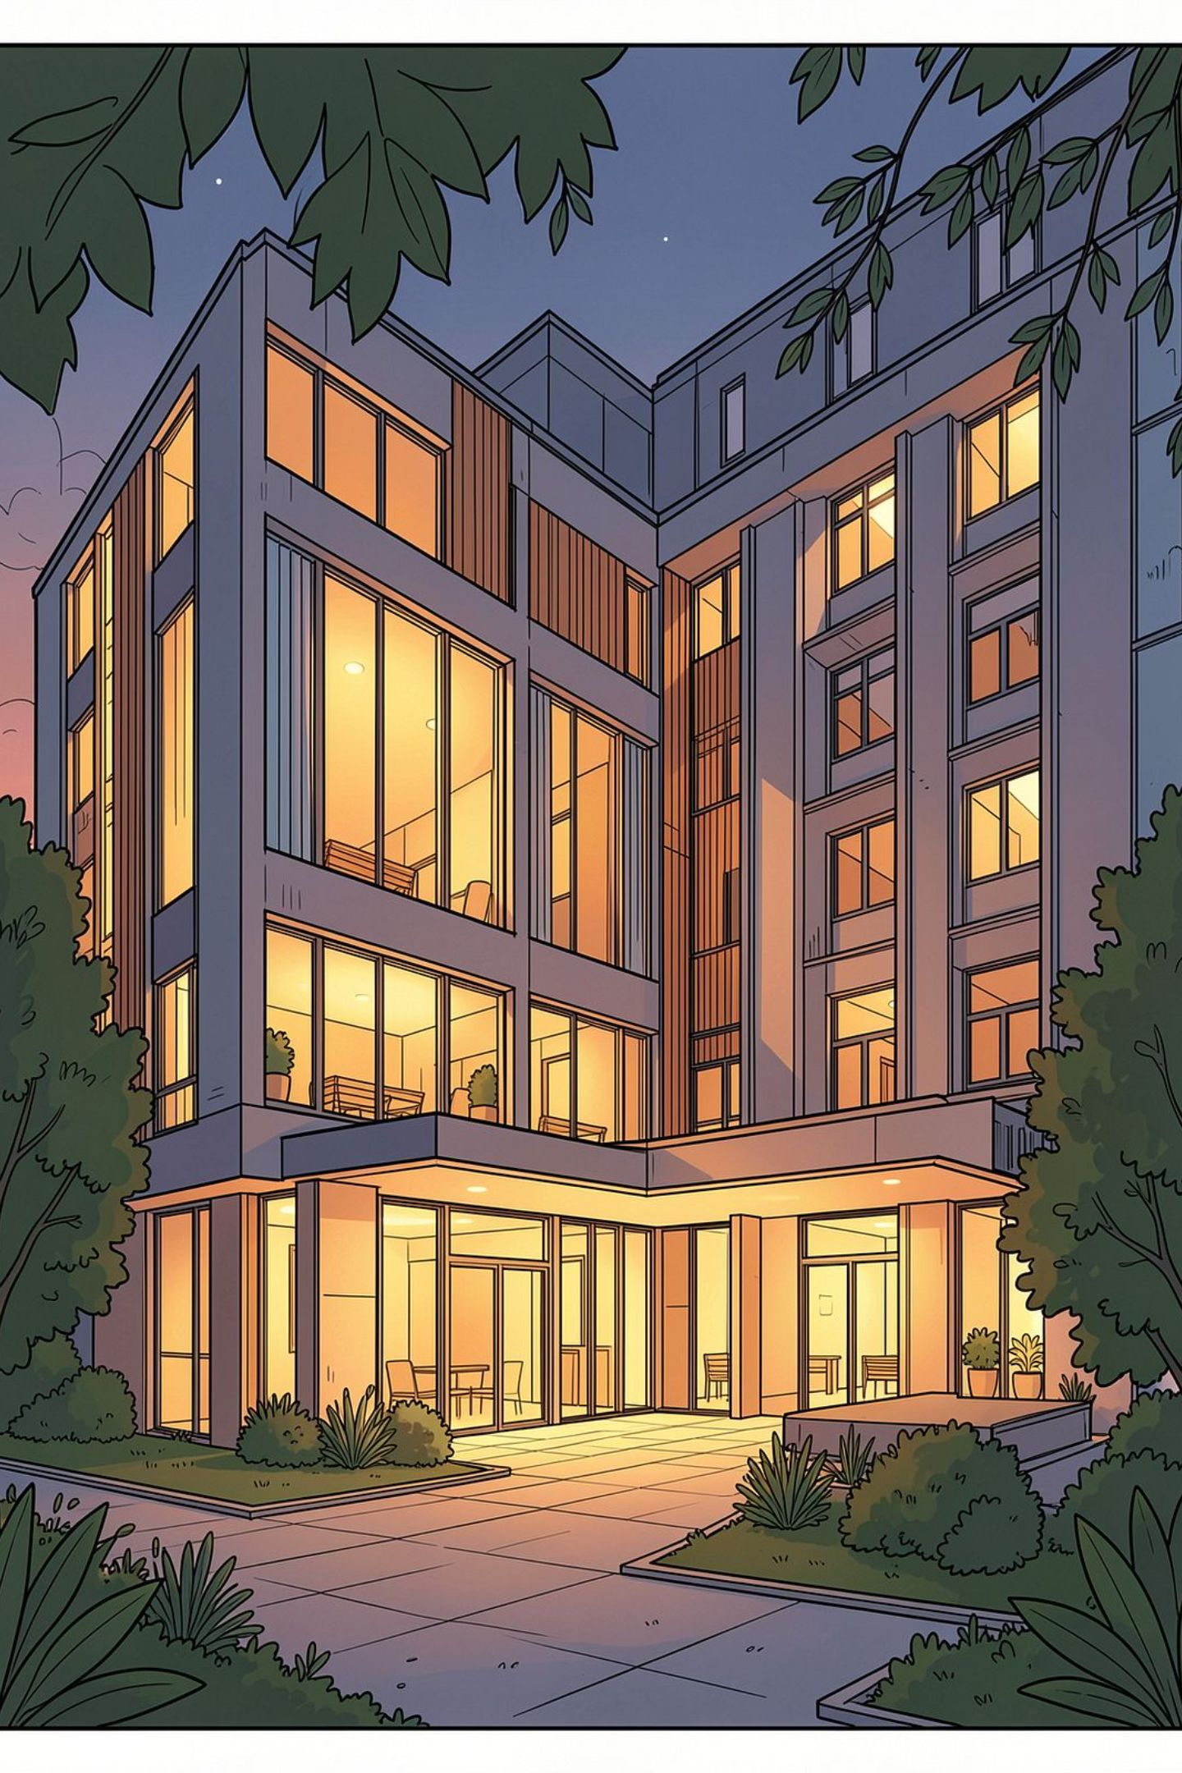
Hostel Outing Permission & Approval Management System
Digitalizing Hostel Outing Approval, Gate Verification & Return Tracking
INTERNSHIP ASSESSMENT PROJECT
FULL-STACK ROLE-BASED WEB APPLICATION
Developed by: Shrikaran P
STUDENT → HOD → WARDEN → WATCHMAN → AUDIT HISTORY

Slide 2
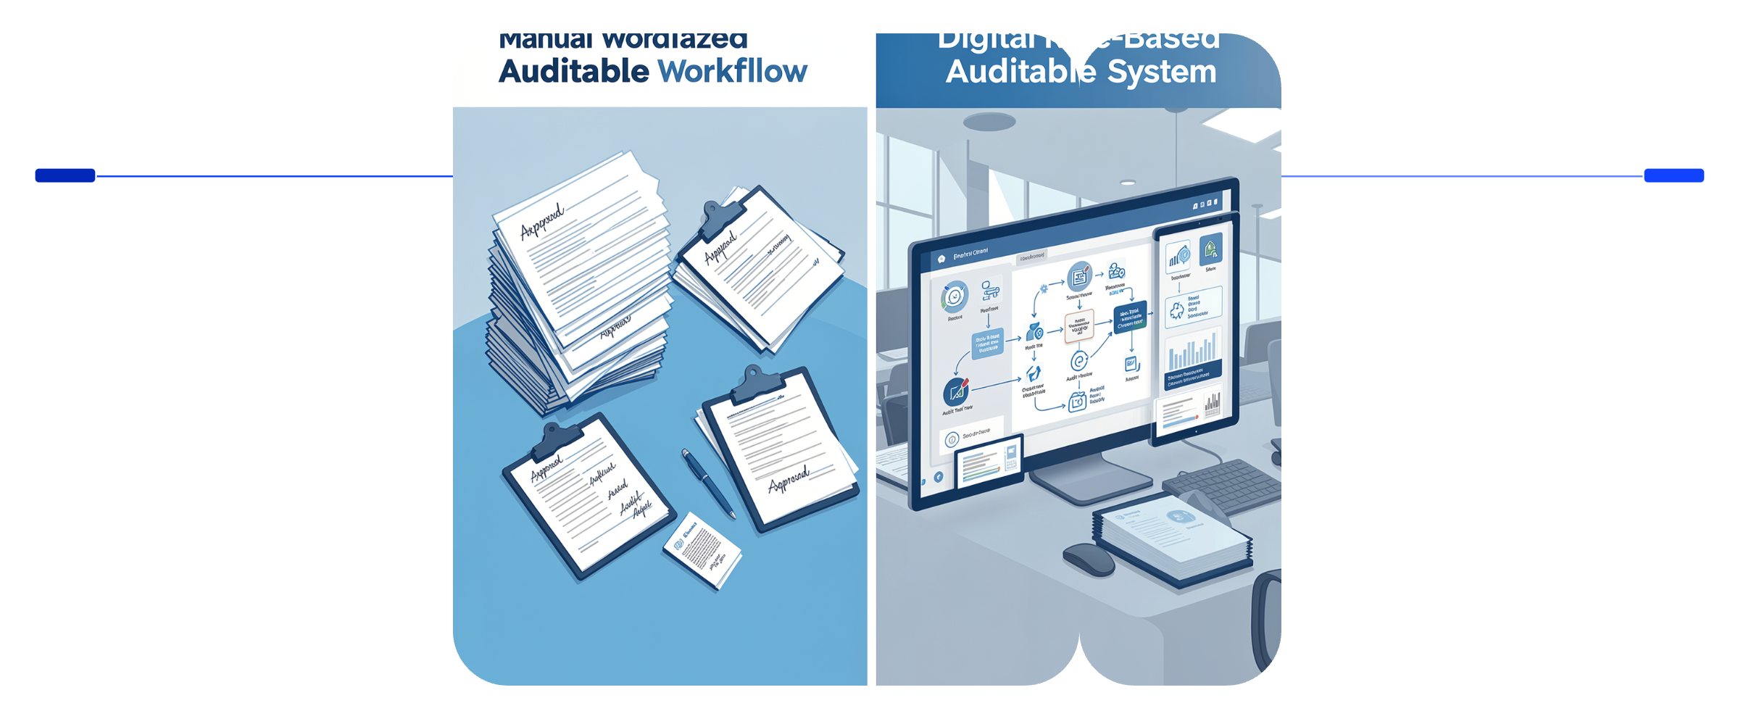
Problem Statement
Traditional Workflow
Key Pain Points
Approval delays
No centralized outing history
Manual gate verification
No return-time tracking
Security & verification risks
Paper Slips
Manual Registers
Phone Calls
No Audit Trail
Traditional
Digital
Paper, manual records, disconnected processes
Centralized, role-based, auditable workflows
Traditional: Paper → Manual → Disconnected vs Digital: Centralized → Role-Based → Auditable

Slide 3
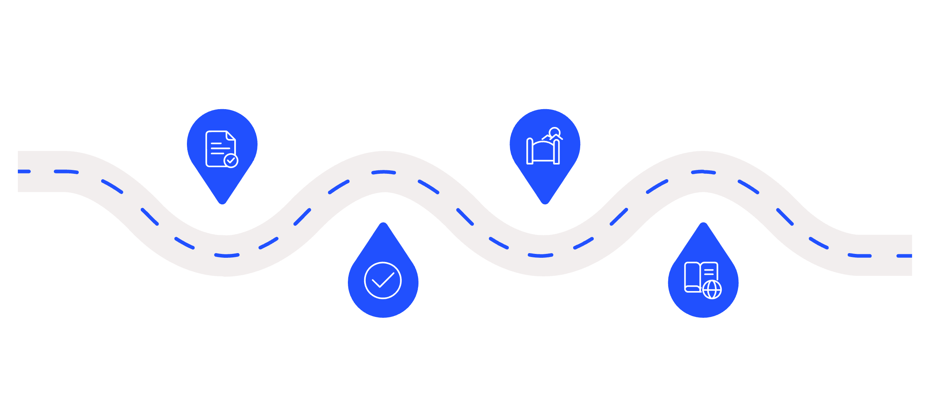
Proposed Solution
One centralized system for the complete outing lifecycle.
Request
Gate Check
Student creates outing request
Watchman verifies and logs exit
Approvals
Audit
HOD then Warden review approvals
Return recorded and audit history
Student request flows through HOD and Warden approval, then gate verification by the Watchman before exit and return logging.
Role-Based Access
Parent Consent
Gate Verification
Late Return Detection

Slide 4





Four User Roles
Student
HOD
Create outing requests
Track status & history
Approve or reject requests
Department-scoped access
Warden
Watchman
Confirm parent consent
Hostel-block-scoped access
Verify approval at gate
Record exit & return

Slide 5
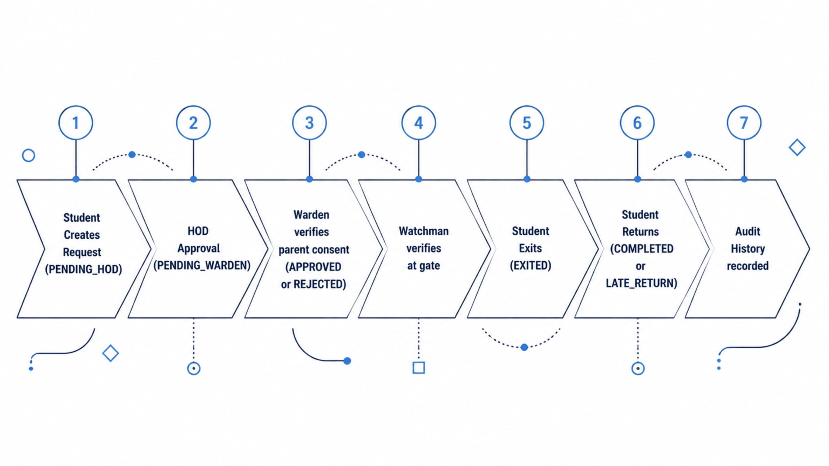
Complete Outing Approval Workflow
Each stage transitions through defined status states: PENDING_HOD → PENDING_WARDEN → APPROVED → EXITED → COMPLETED / LATE_RETURN

Slide 6
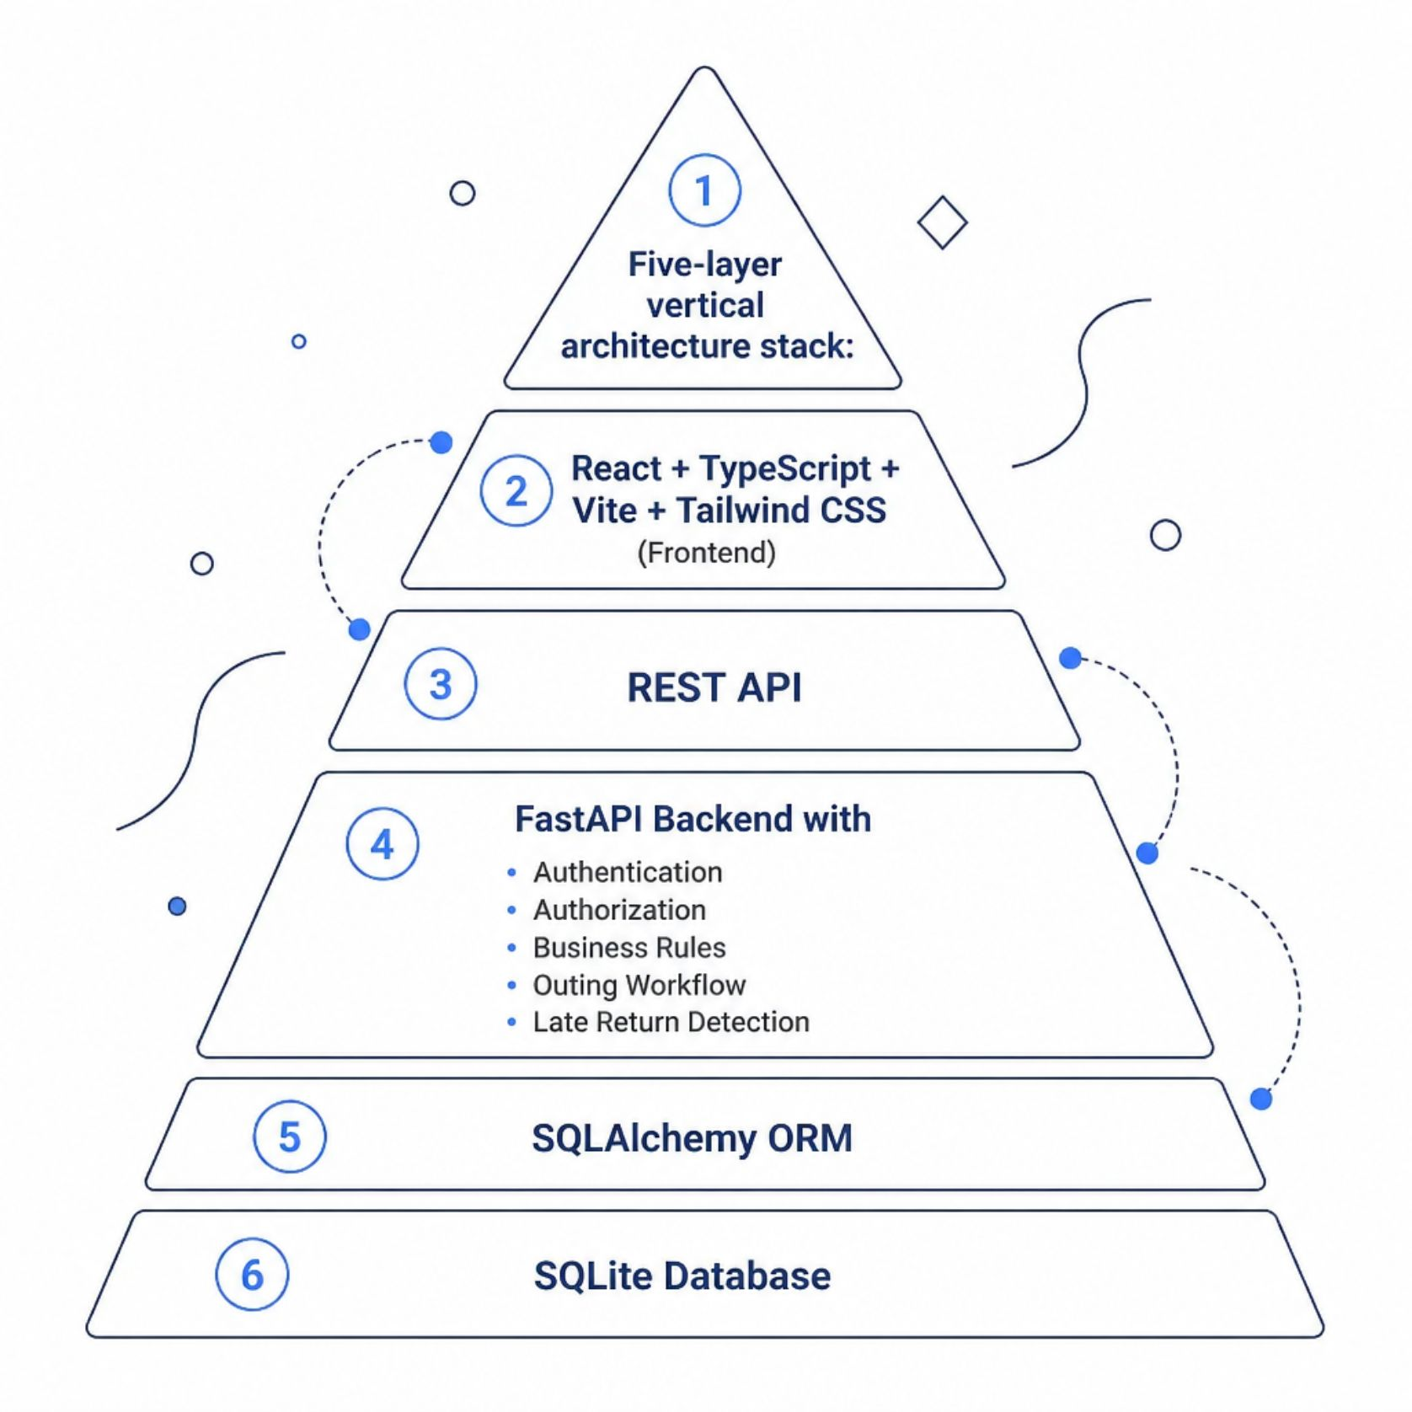
System Architecture
Technology Stack
Frontend
Backend
React · TypeScript · Vite · Tailwind CSS
Python · FastAPI · SQLAlchemy
Auth
Database
JWT · Bcrypt · Role-Based Authorization
SQLite
Frontend → REST API → FastAPI → SQLAlchemy → Database

Slide 7

Database, Security & Access Control
Core Entities
Security Model
JWT authentication + Bcrypt hashing
Backend-enforced authorization
Department & hostel-block scoping
Mandatory parent consent before Warden approval
Full audit history
Users
Departments
Hostel Blocks
Outing Requests
Approval History
Gate Logs
Authorization enforced at the backend, not only the frontend.

Slide 8

Late Return Detection
Calculate Delay
Compute minutes late
Late Return
Actual > Expected
Completed
Actual ≤ Expected
Compare Returns
Check expected vs actual
System compares expected and actual return timestamps to determine outing outcome.
Example
Key Behavior
Expected: 6:00 PM
Actual: 6:35 PM
Result: LATE_RETURN
Delay: 35 minutes
Late students are not blocked from returning — the system records the delay and logs it to audit history.
STAGE 3 REQUIREMENT

Slide 9

Testing & AI-Assisted Development
Automated Testing
Stage 3 AI Change Loop
01
Pytest
New Requirement
Backend unit & integration tests
02
Playwright
AI-Assisted Implementation
End-to-end browser tests
03
Run Tests → Failure (Red)
Frontend Build
TypeScript & production validation
04
AI Diagnosis & Fix
05
Re-Run → Pass (Green)
06
Full Regression

Slide 10
Results & Live Demonstration
System Outcomes
Live Demonstration
Student → HOD → Warden → Watchman → Return → Audit
A centralized, role-based and auditable solution for hostel outing management.
✓ Digitalized Outing Workflow
✓ Role-Based Access Control
✓ Parent Consent Verification
✓ Gate Movement Tracking
✓ Late Return Detection
✓ Centralized Audit History
✓ Automated Backend & E2E Testing
✓ AI-Assisted Stage 3 Change Loop

